Slide 1
Sarnia
GLOBAL ALPHA Fund
Strategy with 20% p.a. target return
Minimum investment: €/$100,000
Liquidity: 3 months
For professional investors only

Slide 2
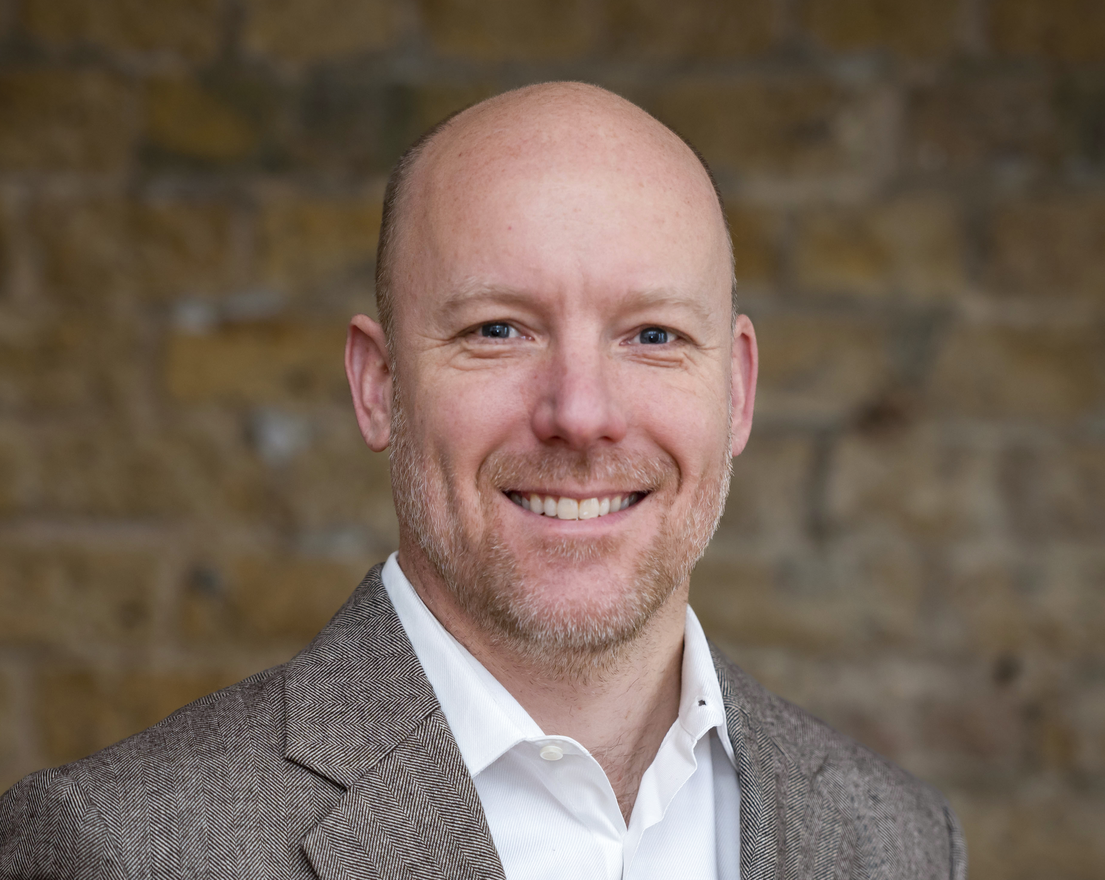
Why I created this fund
Dear Reader,
In 2010, I published a report about a market-leading
but little-known European software company that
I believed to have the potential to multiply in value.
I didn’t have the patience to stick to the position, nor did any other investor I know…Except one!
Michael Steindler saw the investment through, and with some of his position achieved nearly a 100x return.
His investment track record is unique:
From 2000-2022, his personal portfolio grew at over 25% p.a. for a 250x return.
His strategy had a weak period in 2023/24 but returned to strength in 2025 with +21.8%.
Since 2000, Michael’s strategy had positive returns during all 5- and 10-year periods.
This is an audited track record achieved with real money.
For nearly two decades, Michael and I have worked together to explore investment ideas. We have now formalised our relationship to bring his wealth building skills to a global audience. We have created the
Sarnia GLOBAL ALPHA Fund to give investors from around the world access to the investment entity through which Michael manages his personal wealth.
Michael manages the portfolio (a job that requires 24/7 attention), and I contribute new investment ideas (using my sprawling global network).
This fund is for investors who are looking for a 20% p.a. target return. Investments in the fund can be redeemed quarterly, but we would like to have co-investors who invest with at least a three-year horizon.
Sarnia Asset Management is a licensed fund management company based in Guernsey, a top-grade finance jurisdiction. I founded the company because I wanted to be able to create the right fund structure for this purpose, and to have full control over what we offer. You can now use the Sarnia GLOBAL ALPHA Fund to build your nest-egg and grow your wealth.
I cannot guarantee Michael’s future results – but his past performance is promising.
The minimum investment is €/$ 100,000 and we can accept investors from the EU, the US, Switzerland, and 80+ other countries.
Please do reach out if you have any questions – we are here to help!
Regards,
Swen Lorenz,
CEO, Sarnia Asset Management

Slide 3
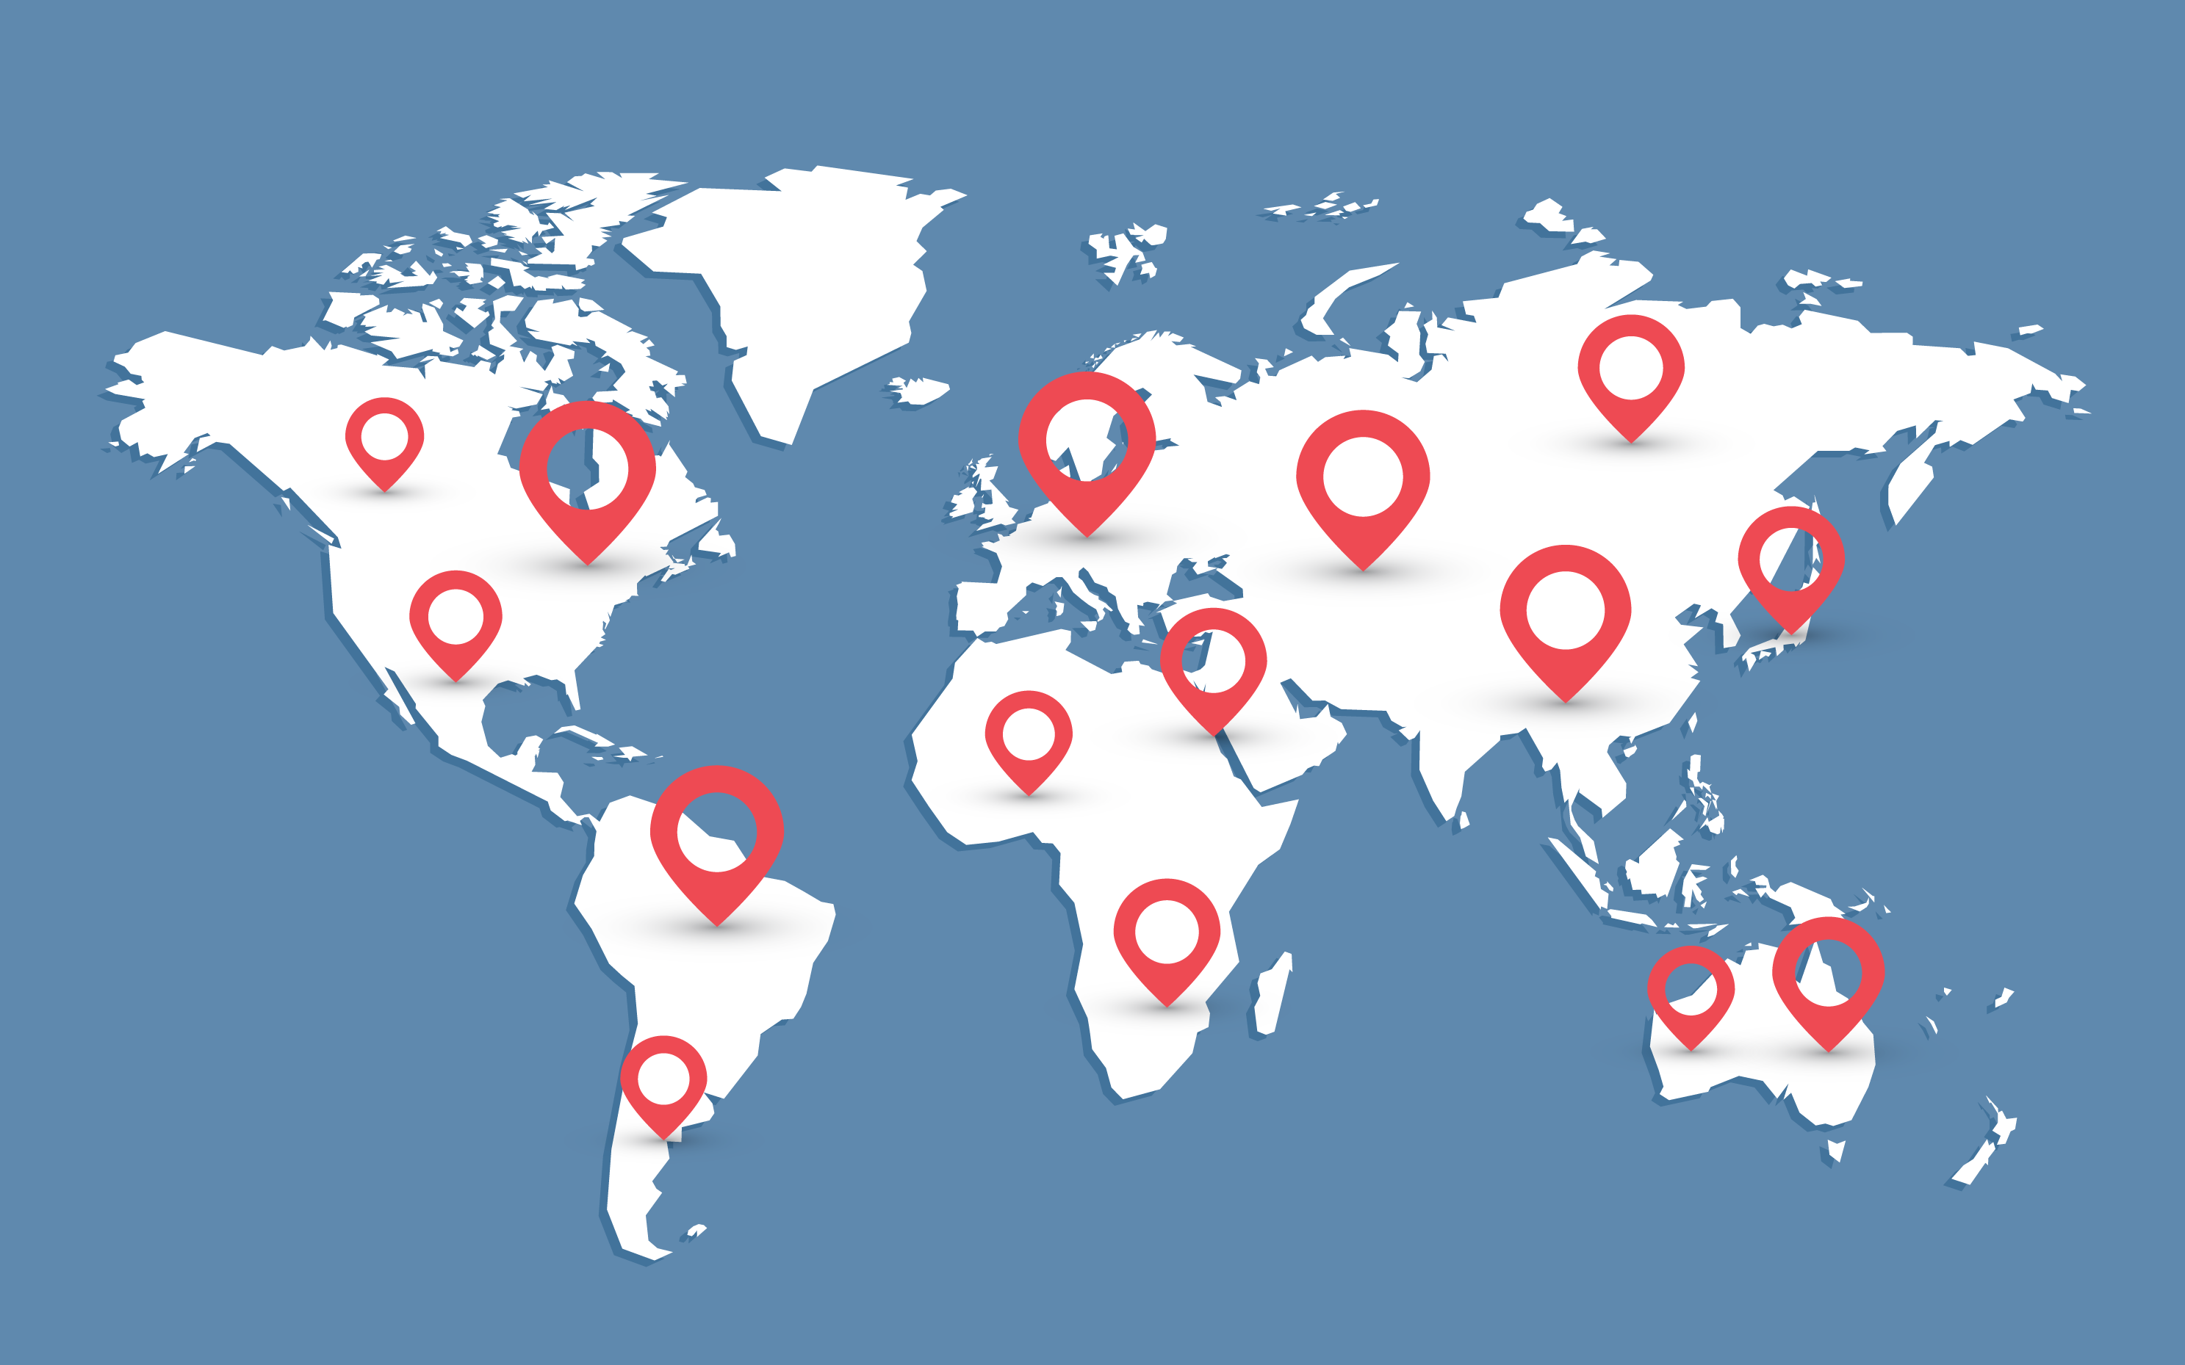

Unconstrained strategy – the focus is maximising your returns
Beyond borders
Are the companies included in the FTSE-100 index "British" when 80% of their revenue is foreign? In our view, investors should view the world as their oyster.
Global vision, stellar results
The strategy developed by the portfolio manager has achieved an average annual return of well above 20% for the period of 2000-2025.
Flexibility for profits
Shift investments where the opportunities are - be it stocks in Europe with strong exposure to US growth or corporate bonds when they’re cheaper than equities.
Minimising risks
Flexibility helps manage risks. Our portfolio manager successfully hedged against turbulence in 2025, and the year-to-date performance in 2026 is +5.2%.
Stay ahead
Adapt to changing global markets and benefit from mispriced assets, wherever in the world they are.
The portfolio is unconstrained in terms of geographies. It currently has a bias towards Europe. However, the Fund invests your money wherever opportunities arise.
Partner with Sarnia GLOBAL ALPHA FUND
to capitalise on a changing world.

Slide 4
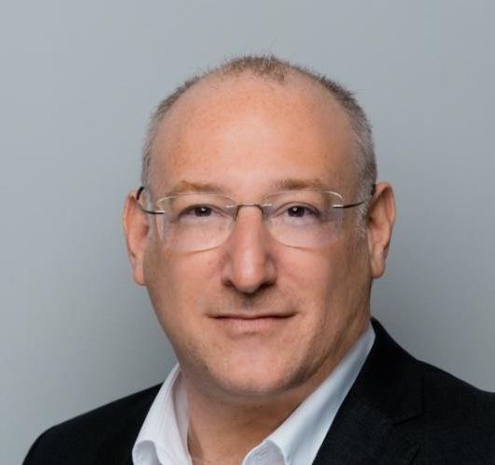
The brain behind our portfolio
Michael studied Business Administration at the European Business School (EBS) before joining Arthur Andersen as a senior real estate consultant. During his work as a consultant, he received a postgraduate degree in Information Technology.
From 2001-2018 he was a portfolio manager at MEAG (Munich RE & ERGO) where he gained institutional experience managing
a €2.7bn portfolio in real estate, real estate funds, listed real estate securities and REITs.
Following an audit of the historical performance of his personal portfolio, Michael decided to turn his strategy into an entity.
His strategy: “I’m looking for long-term growth businesses trading at attractive prices, and I take a contrarian view.”
Unlike most other managers, who are wedded to a particular style (e.g. growth vs value), Michael is extremely flexible in his approach, having identified a range of different patterns of successful stock investments over time. Coupled with his often contrarian approach and his ability to locate under-the-radar situations, this has resulted in an outstanding return profile over an extended period.
Michael has built his track record over three lengthy stock market cycles, proving that his strategy works in the long term and is not just based on lucky strikes.
€1,000 invested in 2000 has grown to over €250,000 today
Michael Steindler, CEFA/CIIA
Portfolio Manager
Michael Steindler is the brain behind a timeless strategy: Buying growth at value prices.
He has been managing this strategy since 2000.
Sarnia Asset Management is partnering with Michael to bring his strategy to a broader audience of investors around the world. You literally invest alongside him.
Finding outlier investment ideas using fundamental analysis is not a profession for Michael – it's his lifelong passion. Investing in this fund means co-investing with Michael. He is 52 and wants to keep working for decades to come.
Michael and Swen have a long-standing personal connection. Michael’s biggest investment outlier – Hypoport – was a company he had read about on Swen’s investment blog, Undervalued-Shares.com, in 2010. He achieved nearly a 100x with some of his position.
Michael divides his time between Munich and Liechtenstein. He loves reading science fiction.
The investment entity that Michael has put much of his personal wealth into is based in Liechtenstein, and it has so far only been available to a limited audience in the DACH region. The Sarnia GLOBAL ALPHA Fund is a user-friendly structure, created to give investors from around the world easier access to Michael’s master fund, without charging any additional fees.

Slide 5

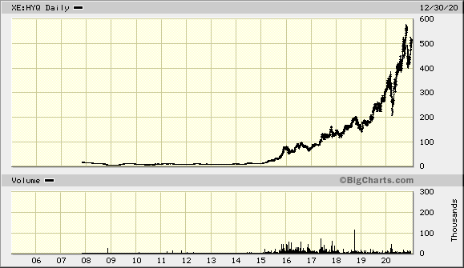
Exemplary investment case #1: Hypoport SE
What was Hypoport about?
Software eats the world – but it’s not only US companies that succeed.
In many countries, local software companies win. Different legal systems, regulatory frameworks, cultures and language can all conspire to give a national firm the edge.
Germany’s Hypoport Group built a network of technology companies that address the B2B mortgage market that exists between banks and other financial services providers in its home market of 84m people.
With a postgrad degree in IT, Michael has significant sector expertise. He located Hypoport as an overlooked, highly promising prospect for a national champion to emerge. When he first invested, the company had a market cap of just €50m. Despite its small size, it already had scalable recurring revenue, and its platform had a strong moat.
One of its founders was offloading shares due to changes in his personal life – i.e. there was sufficient stock available for a meaningful position. This created an opportunity for a non-crowded contrarian trade.
The subsequent rise of high-growth digital financial marketplaces provided the catalyst. It rose >100-fold to a €6bn market cap. With some of his position, our portfolio manager captured nearly all this upside.
Michael spends time on identifying such outliers so you don’t have to.
(He cashed out of Hypoport, but recently bought back into it following the stocks de-rating as part of the ‘SaaS Apocalypse’).
Source: Bigcharts

Slide 6
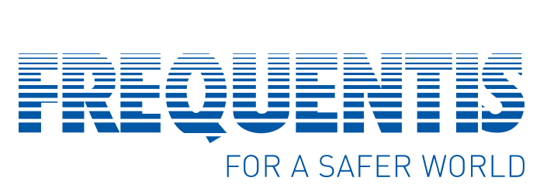
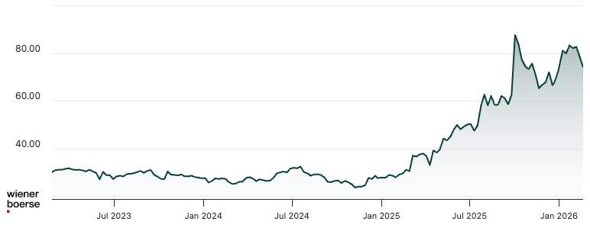
Exemplary investment case #2: Frequentis
What is Frequentis about?
Austria-based Frequentis is the world market leader for communication systems in air traffic control, with a 30% global market share.
In spring 2024, a slowdown in order intake and rising personnel costs led to a weak share price. Michael invested at a share price of EUR 26.
He believed Frequentis was going to accelerate order intake due to:
Global backlog of investment in comms for securing air traffic.
Drone technology for air-based defence is on the rise.
Europe needs other critical infrastructure, e.g. for police and rescue.
Markers that contributed to the decision to invest:
Debt-free balance sheet and net cash.
EV/sales below 1x was too low relative to strong market share.
EUR 400m market cap meant the stock stood to benefit from growing investor interest in second-tier companies following Rheinmetall soaring.
The stock was fundamentally cheap and destined to benefit from secular trends such as the safety of the increasingly crowded skies above us and drone-based warfare.
Since investing, the stock has achieved 3x and as per March 2026 remained among the largest positions in the portfolio.
Data: XXXX

Slide 7
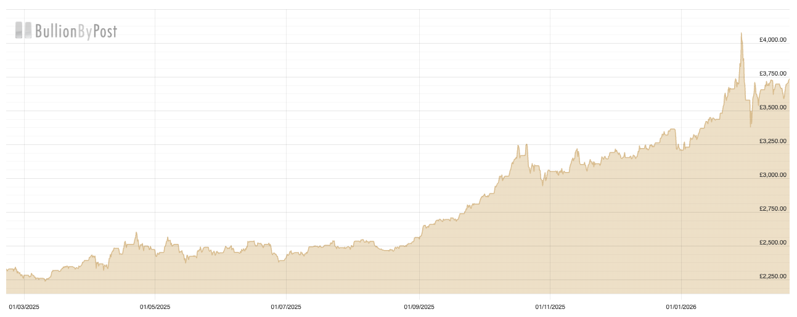
Exemplary investment case #3: Physical gold
What is Gold about?
Gold is the ultimate currency in a world full of uncertainty.
In December 2022, Michael invested in physical gold for the fund at a price of $ 1,800 per ounce.
He believed gold (and other precious metals like silver) would go up in price for several reasons:
Hedge against fiat currency and systematic risk.
Long-term portfolio insurance and diversification.
Massive accumulation by central banks.
Unlike many other fund structures, our setup gives us the flexibility to invest in physical metals. Since investing, the investment in gold has appreciated in value substantially.
The fund remains invested in gold at the time of publication of this deck.
Securing the portfolio against shocks is a vital part of the strategy. The fund has 0% leverage to avoid the risk of margin calls, and it does not use exotic derivatives.
Gold is one of the assets used to hedge the fund in uncertain times.
Physical Gold (USD per ounce)
Data: Bullion by Post, October 2020 – February 2026

Slide 8
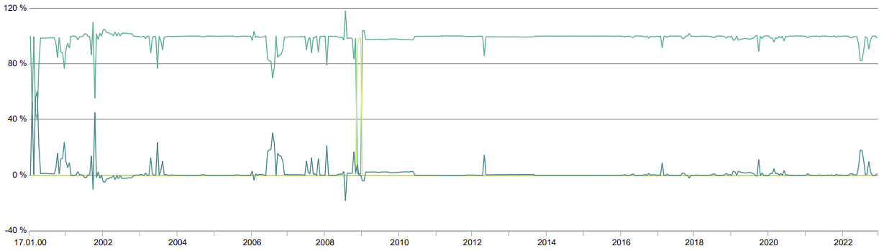
Strategy uses flexibility across asset classes as hedge
2008 GFC: Corporate bonds
briefly 100% portfolio weighting
Shares
Liquidity
Bonds
During the 2008 Great Financial Crisis, corporate bonds were briefly mispriced relative to equities.
Michael’s strategy (then a personal portfolio) was to pile into corporate bonds, finishing the year with +11.4% (net).
Data: Roedl & Partner and DF Deutsche Finance Securities GmbH

Slide 9
Typical investment criteria
Platforms
with strong resilience/
brand/moat
5. Potential takeover target
Revenue models that are scalable and/or recurring revenue
4. Near-term
value catalysts
7. Attractive earnings multiple and risk-return profile
3. Discount to NAV and/or
peer group
6. Non-crowded trade/contrarian

Slide 10
Key parameters of the strategy
10 – 20
core positions
Unconstrained
Concentrated
portfolio
FOCUS
Opportunistically pursue
market inefficiencies
anywhere in the world.
Concentrated portfolio.
Currently mostly small and mid cap equities
and commodities.
Up to 30% concentration
in a single position.
High historical
net returns
> 20% p.a.
0% Leverage
RETURN
25-year net performance:
average ≈24% p.a.
(audited, real-money performance)
Net return target
(over 3-year period).
Fund never subject to margin calls.
Derivates only for hedging
(“portfolio insurance”).
Exclusive
investment strategy
Skin in the game
MANAGEMENT
Portfolio manager has invested a
significant amount of his own money.
Limited capacity,
soft close expected at €200m.

Slide 11
Typical portfolio composition
CORE
EQUITY PORTFOLIO
SATELLITE
EQUITY PORTFOLIO
The Core Portfolio consists of the
stocks in which the portfolio manager
has a high degree of conviction.
The Satellite Portfolio consists
of the stocks in which the portfolio manager has taken an active interest
but are yet to “earn” a
place in the Core Portfolio.
10-20 core positions
Permission to invest up to 30%
of the portfolio in a single stock
(though typically 2.5% - 10%).
Weightings of
< 2.5%
No constraint to
the number of positions.
Your Fund has the flexibility to hold up to 100% cash or bonds.
Truly differentiated investment ideas, no benchmarking.

Slide 12
Track record 2000 – 2026
00
01
02
03
04
05
06
07
08
09
10
11
12
13
14
15
16
17
18
19
20
21
22
23
24
25
30/04/26
The strategy has an outstanding track record, but it comes with unavoidable periods of volatility and weakness.
Investors should only invest capital they can commit for at least three years.
Data: Roedl & Partner and DF Deutsche Finance Securities GmbH

Slide 13
Current portfolio composition (per 30 April 2026)
 | 94.7% – Shares
 | 4.9% – Commodities
 | 0.5% – Other (e.g. hedge)
 | 0.0% – Bonds
 | 0.0% – Cash
 | 37.7% – Technology
 | 19.5% – Consumer (non-cyclical)
 | 17.3% – Communication
 | 9.0% – Finance
 | 16.5% – Other
Investment
categories
Sectoral
breakdown
Top 5 positions
 | 23.5% – Germany
 | 15.6% – USA
 | 15.0% – Japan
 | 8.9% – Israel
 | 37.0% – Other
 | 37.7% – EUR
 | 28.0% – USD
 | 15.0% – JPY
 | 4.1% – CHF
 | 15.2% – Other
Currency
breakdown
Regions
Top 5 positions
Ask us for the monthly Fund Manager Commentary & Factsheet.
It discusses some individual positions, past and present.

Slide 14
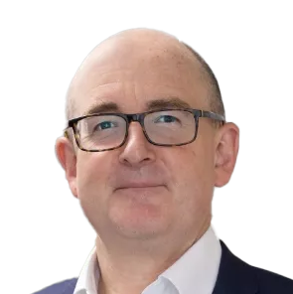
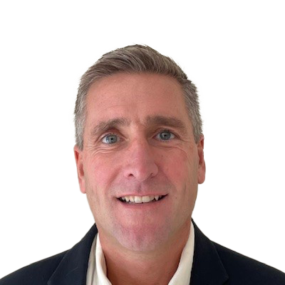
The team supervising the portfolio manager
Swen Lorenz
Founder &
Chief Executive Officer,
Sarnia Asset Management
Joe Truelove
Independent Director
Sarnia GLOBAL ALPHA Fund
Swen has built a reputation for uncovering undervalued companies, resulting in an online following of many thousands of private investors (and growing).
With Sarnia Asset Management, he is building a firm that caters to high-net-worth investors who are looking for products that generate alpha, and where the portfolio managers have real skin in the game. He is passionate about helping private investors gain access to products which would not otherwise be available to them.
Swen has had a long and close working relationship with Michael Steindler over the years. As a director of the fund, Swen also adds active input to the investment strategy and its idea origination.
Sarnia Asset Management is co-owned by a group of private investors who backed the firm because they wanted someone to create products of this kind. Shareholders of Sarnia Asset Management will be among the initial subscribers to the GLOBAL ALPHA Fund at launch.
Joe is one of the two independent directors that supervise the fund’s management. He has over 25 years’ experience in financial services, including roles in audit, financial control, operations and fund administration. He is a Fellow of the Institute of Chartered Accountants in England and Wales, and his experience includes private equity, VC, real estate, infrastructure, securities and debt. Joe has been a Guernsey resident for 50 years.
Luke Allen
Independent Director
Sarnia GLOBAL ALPHA Fund
Luke is the second independent director of the fund. He has 31 years’ experience working in the financial sector. Until 2019 he was the CEO and MD of Man Group plc’s Guernsey office, which serviced an extensive range of hedge funds and funds of hedge funds. He has experience in a wide range of structures across asset classes and jurisdictions. Luke is a lifelong Guernsey resident.

Slide 15
Frequently asked questions (1/2)
“Do I have to open a bank account in Guernsey to invest in the
Sarnia GLOBAL ALPHA Fund?”
“Where are my shares in the fund held?”
They are held in a share register that is administered by Beauvoir Group, a licensed fiduciary in Guernsey. Beauvoir Group was established in 1998 by local entrepreneurs who still own the business. The firm serves high-net-worth individuals, family offices and corporate clients for services in fund administration, trusts and related areas. Its clients include prominent families and institutions. Sarnia Asset Management has worked with Beauvoir for several years and is using their services for the operational backbone of its fund management business. You can find more information about them on their website.
“Do I get tailor-made reporting for tax purposes?”
No, you do not have to
open a new bank account to invest in this fund.
Yes, we are set up to provide reporting for tax purposes for different countries. Guernsey is an international financial centre that is experienced in dealing with clients from around the world.
“Can I send my investment in US dollars?”
Yes, you can transfer US dollars.

Slide 16
Frequently asked questions (2/2)
“Isn’t it quite steep to charge an annual management fee of 2%?”
“I am based in Germany. Couldn’t I invest directly into Steindler’s Liechtenstein entity?”
Our firm makes no money at all from the management fee. Operating a licensed fund management company in a Grade A jurisdiction is simply very expensive nowadays, especially if you are a small firm. The management fee keeps our lights on. We only make money from performance fees, which means our interests are fully aligned with our investors.
You could, and we are happy to point you in the right direction for doing so. However, you would not get access to the additional information we publish about the Fund (see next slide), the webinars and events we host for investors of the Sarnia GLOBAL ALPHA Fund, or the additional supervision that the team of Sarnia Asset Management provides. Investing through our Guernsey feeder fund has these additional benefits and costs zero in additional fees, because of the unique arrangement we have with Michael Steindler.
Additionally, owning the fund through Guernsey diversifies your funds to a neutral, stable jurisdiction.
German investors who want to invest through Liechtenstein require a minimum of € 200k, but investing via Guernsey only requires a minimum of € 100k.
“I have never subscribed to such a fund. Will you help me fill out the subscription documents?”
We have made extra effort to make the unavoidable bureaucracy as easy to deal with as possible. Besides that, we are always happy to jump on a call or answer emails if you have any questions.
“How fast can I get my money back when I need it?”
The fund has quarterly withdrawal dates. This means investors can cash out every quarter and need to give 30 days notice. The Fund requires this period so that it never has to sell investments in a hurried fashion, which protects the Fund’s investors from fire-sales.

Slide 17
Keeping you informed
Our investors have different preferences for staying informed. We offer the following:
MONTHLY
FACTSHEET
QUARTERLY
CALL
ANNUAL MEET-UP
Once a month, you receive a two-page document that contains the most pertinent information about the Fund, including commentary authored by Swen and approved by Michael. Fund investors receive it automatically, everyone else can ask to be added to the email list or download it through the website. You can also use the factsheet to follow the fund for a while before investing.
Once a quarter we host a call where Swen and Michael update you on the latest developments and answer any questions you have. These webinars are exclusively for the investors of the Sarnia GLOBAL ALPHA Fund and are co-hosted by Swen and Michael. Being on the list for these calls is like being a member of an exclusive club.
Once a year, we offer our investors the opportunity to meet Swen and Michael in person in Munich, London and
New York. This too, is exclusively available to the investors of the Sarnia GLOBAL ALPHA Fund.

Slide 18
Structure – Feeder fund with 0% additional fees
Investors from around the world
(EU, UK, US, CH, HK,
and 80 other countries).
Sarnia GLOBAL ALPHA Fund, Guernsey
0% additional fees
(exclusive feeder fund arrangement)
Accuro Global Alpha Fund
Liechtenstein
2+20% fees
Invests
Supervises
Additional oversight, input
and reporting
Manages
Sarnia AM Limited,
Licensed Fund Manager
Fund’s Board of Directors:
Lorenz, Truelove, Allen
Michael Steindler
Portfolio Manager
Fee sharing agreement

Slide 19
Terms and conditions of the Sarnia GLOBAL ALPHA Fund
Minimum Initial Investment | € / $ 100,000
Share Classes | Separate share classes for EUR and USD (otherwise identical)
Base Currency | EUR and USD
Management Fee | 2% p.a. *
Performance Fee | 20% above 6% hurdle (incl. high water mark) *
Liquidity | Quarterly
Notice Period | 30 days
Fund Type | Guernsey Qualifying Private Investment Fund (= accredited/professional investors only)
Administrator | Beauvoir Corporate and Fund Services Limited, Guernsey
Custodian & Depository | Butterfield Bank (Guernsey) Limited, Guernsey
Auditor | Grant Thornton Limited, Guernsey
Legal Counsel | Carey Olsen, Guernsey
Regulator | Guernsey Financial Services Commission (GFSC)
* Feeder fund does not levy any additional management fees; Sarnia Asset Management is paid through a fee-splitting agreement with the Liechtenstein fund administrator entity.

Slide 20
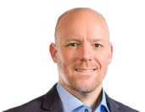
Questions – Do not hesitate to reach out to us!
Disclaimer
This presentation is provided to you on a confidential basis for your general information only. It is not a solicitation or an offer to buy or sell any financial instruments, nor is it an invitation or inducement to engage in investment activity and should not be construed as such. This document is intended only for the person to whom it is issued by Sarnia Asset Management Limited. Participation in any fund or investment product sponsored, advised or managed by Sarnia Asset Management Limited will only be offered pursuant to the terms of detailed documentation relating thereto and only to the extent that such offer is in compliance with applicable law in the jurisdiction in which such offer is made. No public offering of securities is being made, and this presentation is not for circulation or onward communication to any person in any jurisdiction in which it is unlawful for such person to make such a communication. Persons receiving this presentation are required to inform themselves about, and comply with, any restrictions in their relevant jurisdiction. No information contained in this presentation should be deemed to constitute the provision of financial, investment, accounting, tax, legal or other professional advice in any way.
It may not be reproduced either in whole or in part without the written permission of Sarnia Asset Management Limited. Sarnia Asset Management Limited is licensed by the Guernsey Financial Services Commission. Sarnia Asset Management (UK) Limited is an appointed representative of Varramore Partners Limited which is authorised and regulated by the Financial Conduct Authority in the United Kingdom.
For accredited investors/professional clients only. Not to be distributed to retail clients. Past performance is no indicator of future performance. Capital at risk.
This presentation may include certain opinions, descriptions, statements, estimates and conclusions in relation to a potential fund or investment product which may turn out to be incorrect. Sarnia Asset Management Limited and/or its employees accept no liability whatsoever for any direct or consequential loss or damages of any kind arising out of the use of this website or any part of its content.
In case of any questions regarding the material in the presentation, please contact Sarnia Asset Management Limited.
Swen Lorenz
Chief Executive Officer
Sarnia AM Limited
swen@sarnia-am.com
Cellphone: +44 75 1554 2707
Registered office:
Sarnia Asset Management Limited
2nd Floor, Lefebvre Place
Lefebvre St
St. Peter Port
Guernsey
GY1 2JP
Channel Islands

